Slide 1
Generative models: applications computer vision
黄道吉 元培学院

Slide 2
Outline
GAN for high res. generation
Large scale training
Style-based generation / style transfer
Video-to-video translation
Texture synthesis
Applications in object detection

Slide 3
High res. generation
GAN: produce sharp images unlike VAE, but…
Random gradient directions
Easier to tell the generated images from GT images
Large resolutions-> smaller batchsize -> unstable training
Solution: progressive growing of G and D
Start with low-res images
Then add new layers as training progresses

Slide 4
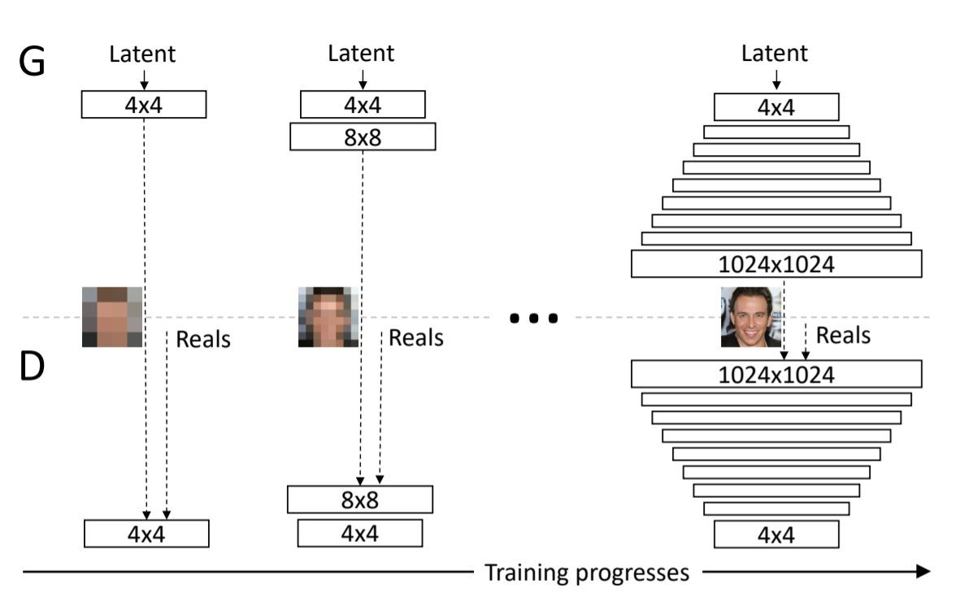
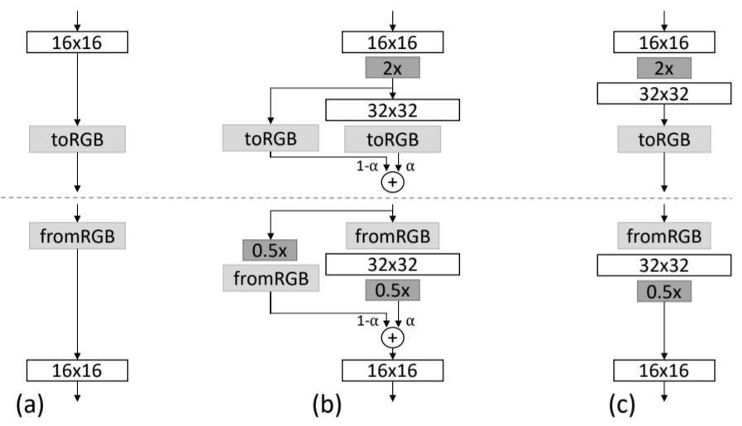
Progressive growing of GANs
First discover large scale structure
Stable training: less modes
New layers fade in smoothly
alpha: 0->1 linearly

Slide 5
Progressive growing of GANs
Training configurations
GANs’ tendency to capture a subset of variation in training data -> concat. minibatch STD(mean of STD for each feature in all location)
Rescale weights at runtime, w_i = w_i / c: adaptive SGD methods normalize gradient using estimated STD, making it possible that a lr is both too large and too small at the same time
Normalize feature vector in each pixel to unit length

Slide 6
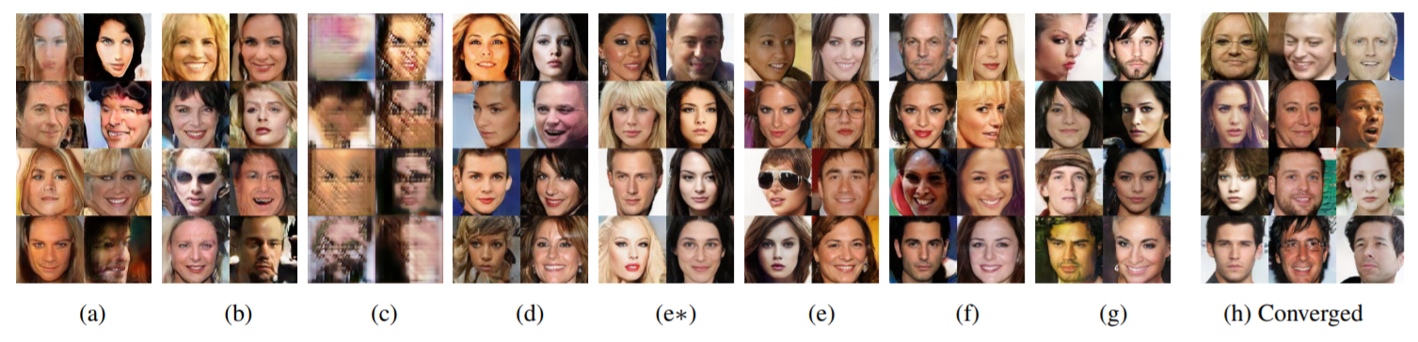
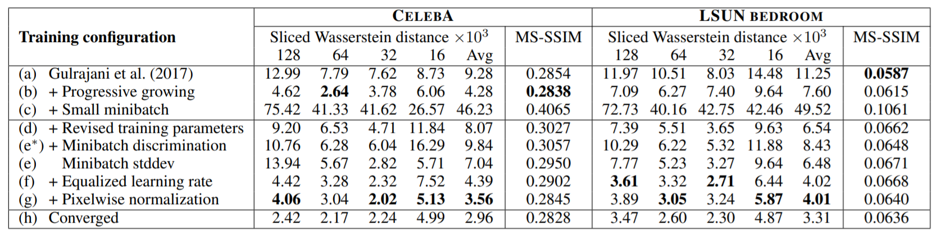
Progressive growing of GANs
Training configuration
(a) batch norm+layer norm
(c) bs:64->16, enable high res. output
(d) hyperparam. –batch/layer norm
Notes:
MSSSIM unable to capture artfifacts, SWd appox. to EMD btw. descriptors

Slide 7
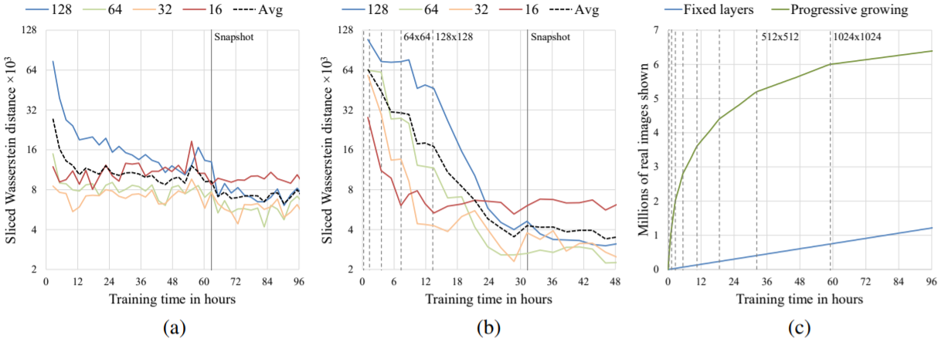
Progressive growing of GANs
Convergence and training speed
Better optimum using less time
Speed up training at early stage

Slide 8
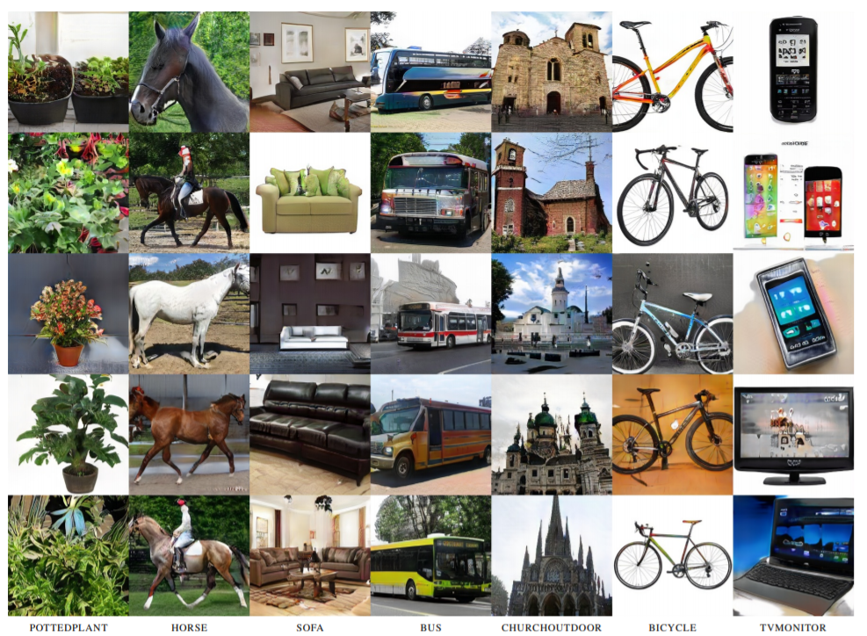
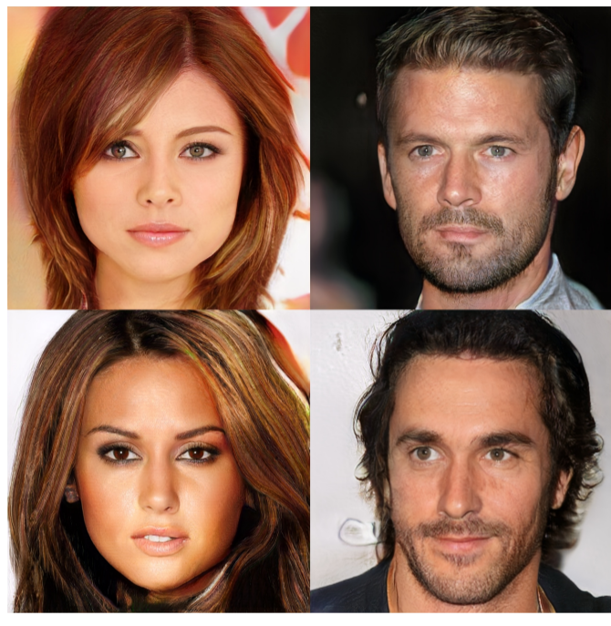
Progressive growing of GANs
Qualitative results

Slide 9
High res. generation
GAN: produce sharp images unlike VAE, but…
Random gradient directions
Easier to tell the generated images from GT images
Large resolutions-> smaller batchsize -> unstable training
Solution: large scale training
4x params. 8x batch size
Truncation trick

Slide 10
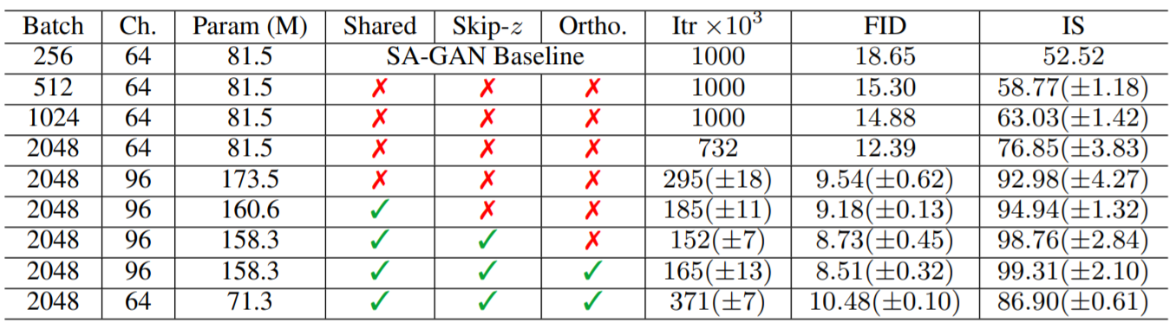
Large scale training
Increase batch size: each batch cover more modes
Increase # of channels: capacity
Shared: class label linearly projected to each layers’ gains and biases

Slide 11
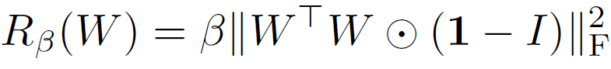
Large scale training
Ortho: regularize weights
Conditioning G to be smooth
s.t. a full space of z ~N(0, 1) can map to good results
Notes:
Weaker version of \beta \| w^{T}w – I \|^{2}_{F}

Slide 12
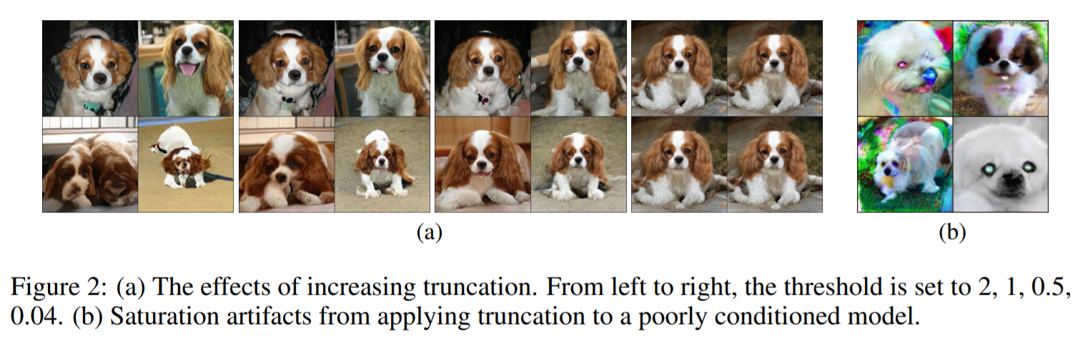
Large scale training
Truncation trick
Training with z~N(0, 1), sampling z from a truncated normal
Tradeoff variety and fidelity
Notes:
Weaker version of \beta \| w^{T}w – I \|^{2}_{F}

Slide 13
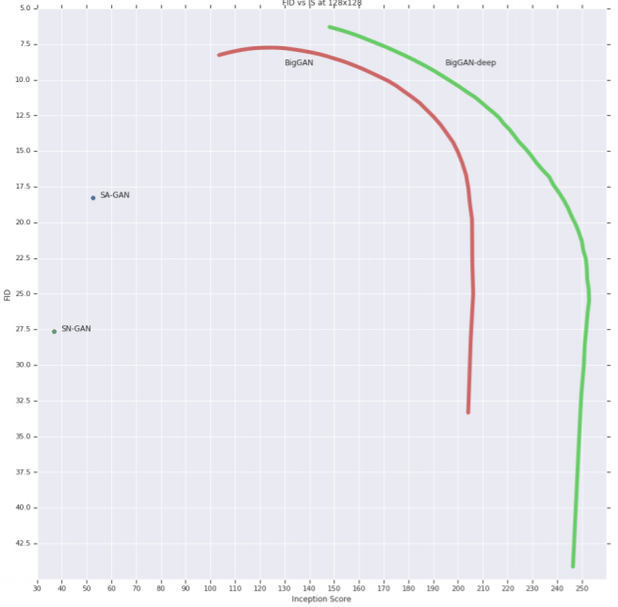
Large scale training
Truncation trick
Training with z~N(0, 1), sampling z from a truncated normal
Tradeoff variety and fidelity
IS does not penalize lack of variety
FID penalizes lack of variety, rewards fidelity
Notes:
Weaker version of \beta \| w^{T}w – I \|^{2}_{F}

Slide 14
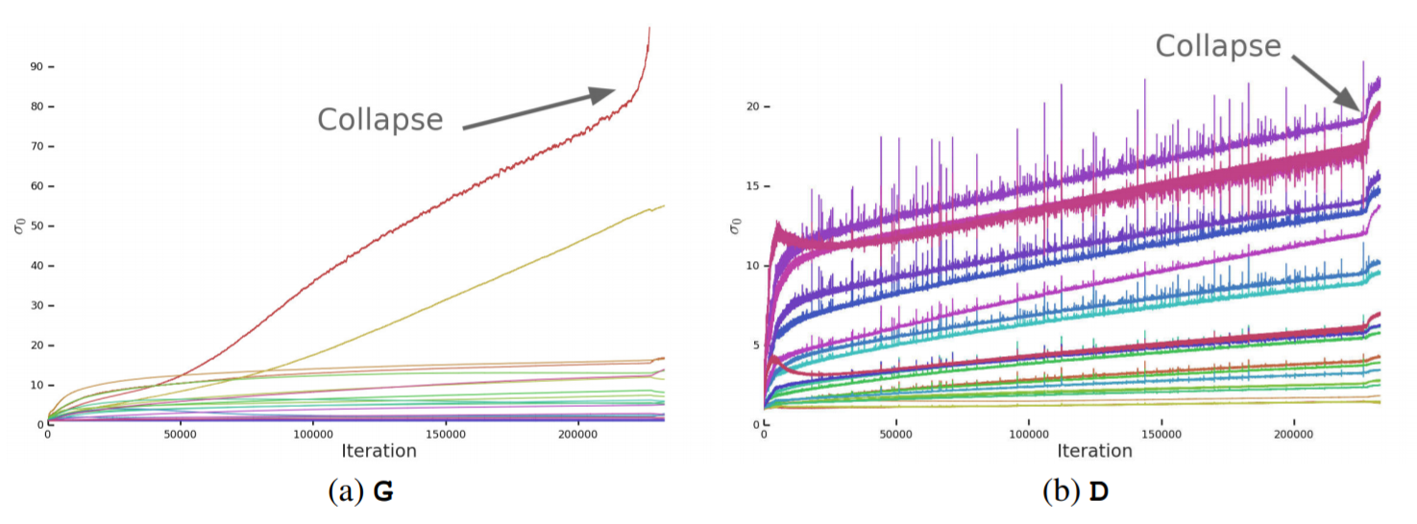
Large scale training
Analysis
Generator: first singular value explode at collapse -> clamp \sigma_0
Improve stability but insufficient
Discriminator: sigma_0 only jumps at collapse
Noise from adv. training, employing GP hurts performance
Overfits to training set: 98% acc. On training set, 50-55% on validation set
Notes:
Some instabilities only occur at large scale

Slide 15
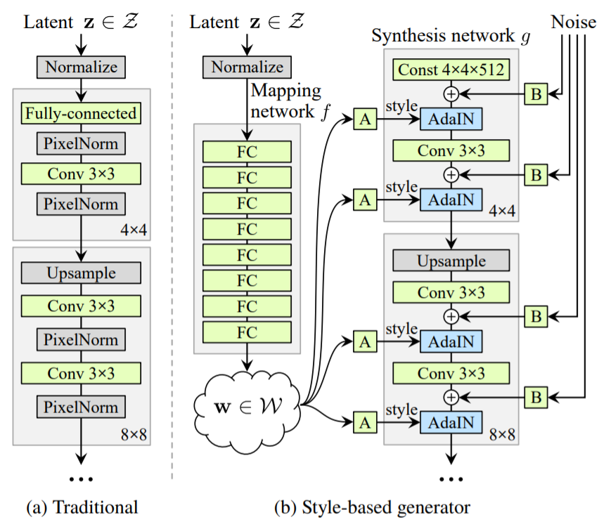
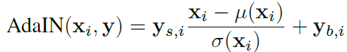
Style based image synthesis
Goal: disentangle high-level attributes
pose/identity, structure/appearance
StyleGAN – unsupervised separation
Omit the input layer
Feed latent code through AdaIN
Stochastic detail by explicit noise
Notes:
Unavoidable entanglement: input latent space follows training data

Slide 16
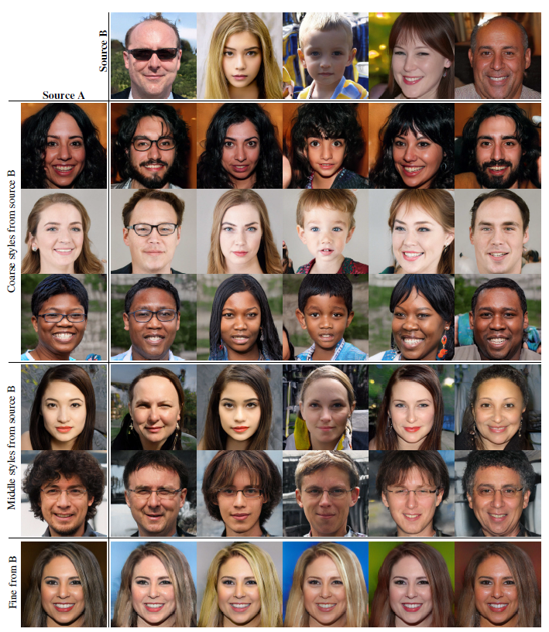
Style based image synthesis
StyleGAN – unsupervised separation
Style mixing: switch from one latent code to another
Stochastic variation
Notes:
Unavoidable entanglement: input latent space follows training data

Slide 17
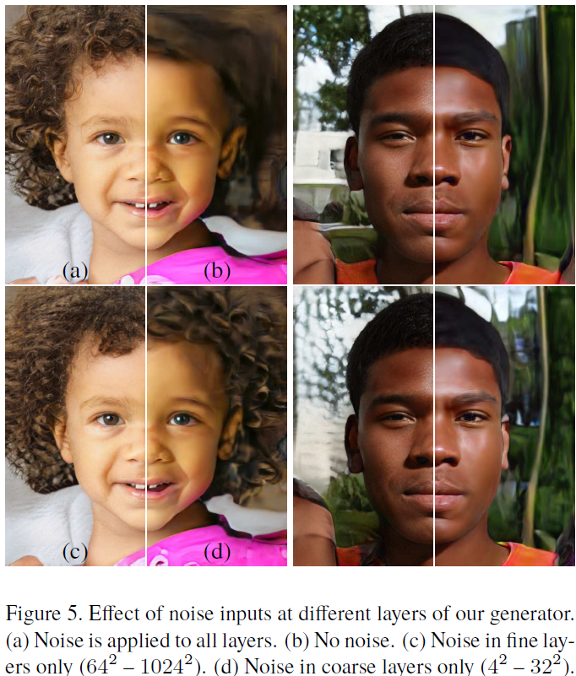
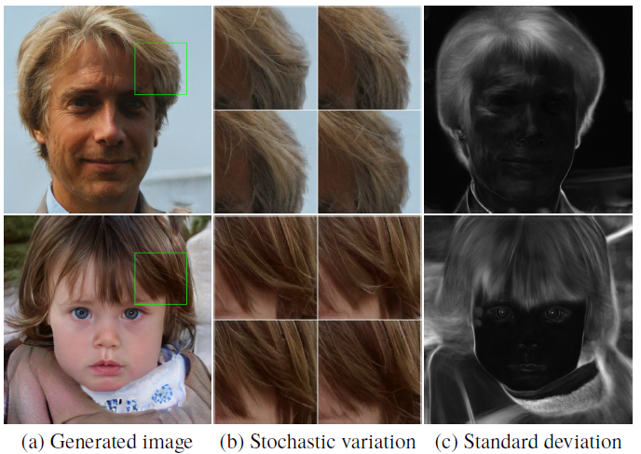
Style based image synthesis
StyleGAN – unsupervised separation
Style mixing: switch from one latent code to another
Stochastic variation
Notes:
Unavoidable entanglement: input latent space follows training data

Slide 18
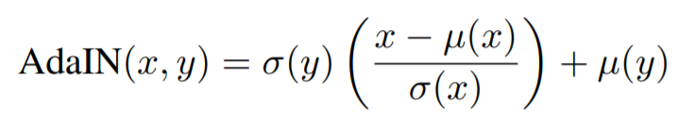
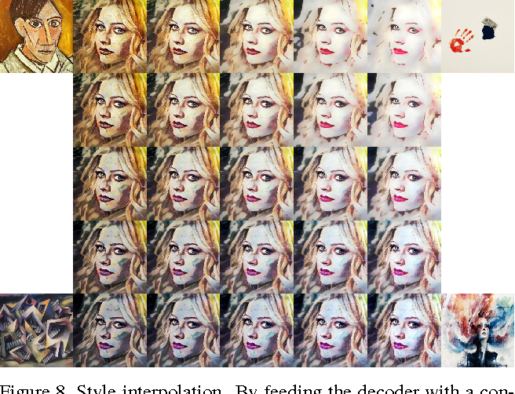
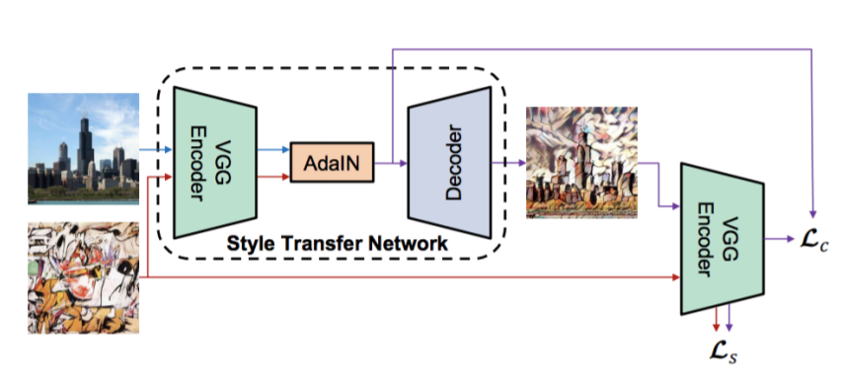
Style based image synthesis
AdaIN revisited
Transfer high level statistics conditioned on ref. image
Transfer arbitrary styles
Notes:
Unavoidable entanglement: input latent space follows training data

Slide 19
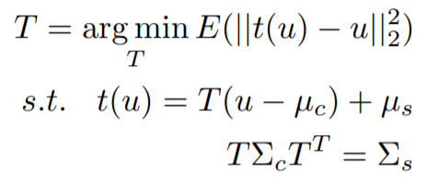
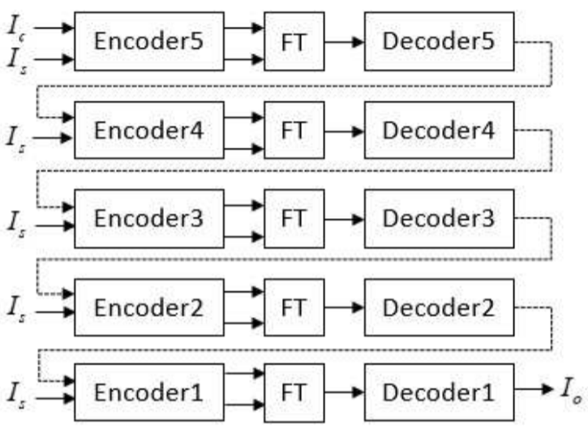
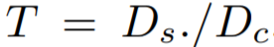
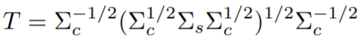
Style based image synthesis
Closed-form solution
A general formulation from optimal transport
For AdaIN
Closed-form solution
Notes:
Min. content loss; the columns of Fc and Fs as samples from N(µc, Σc) and N(µs, Σs)

Slide 20
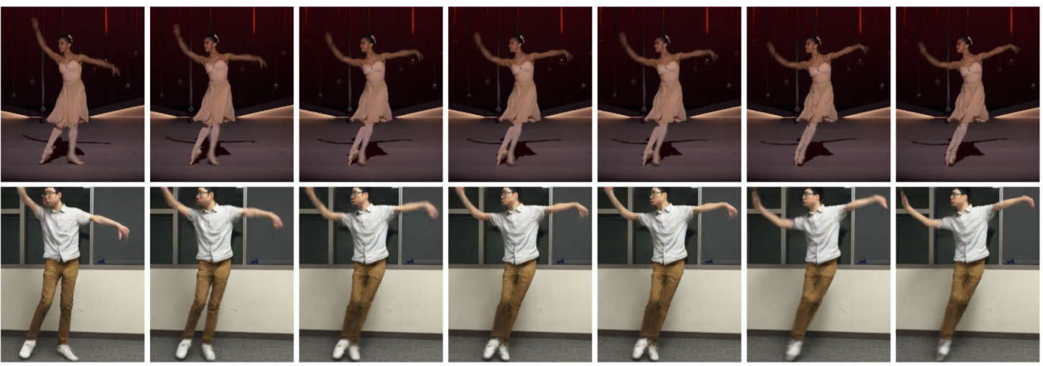
Video2video translation
Everybody dance now
Video as an image sequence
Motion transfer using pose as intermediate representation

Slide 21
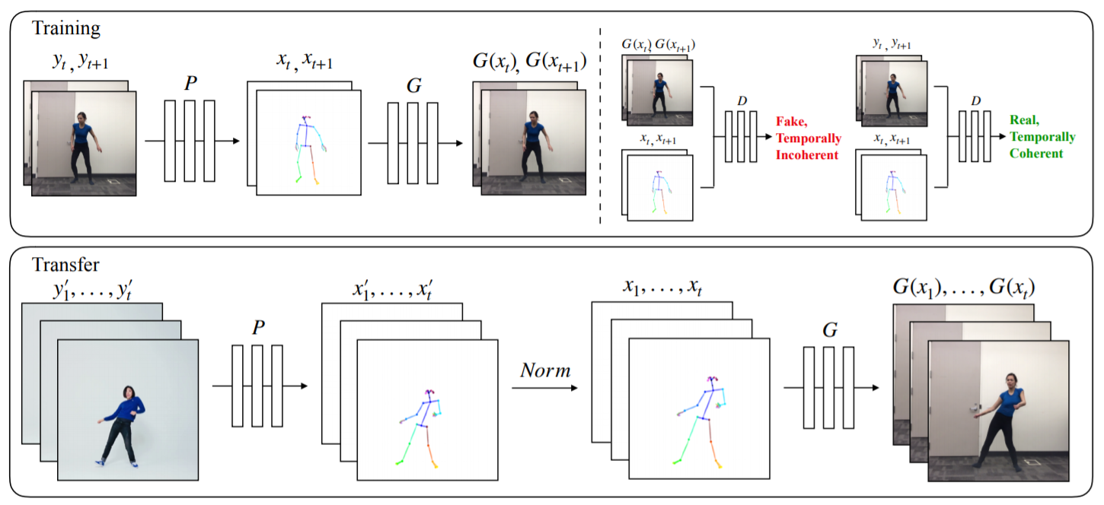
Video2video translation
Everybody dance now
Pretrained SOTA pose detector
Temporal smoothing:
second frame conditioned on first one
first frame conditioned on zero image
Notes:
Plot keypoints, draw lines between connected points; norm: heights, ankle position

Slide 22
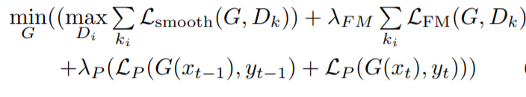
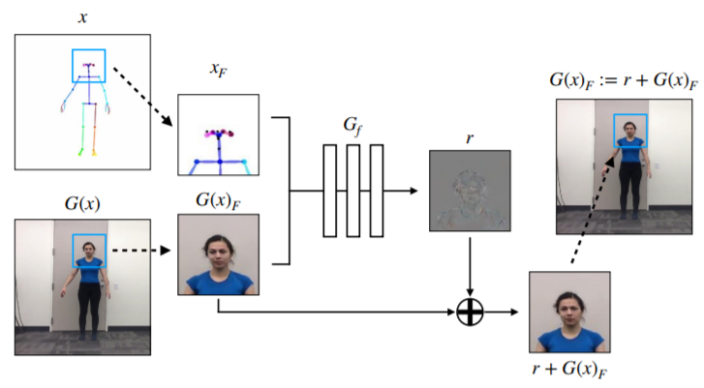
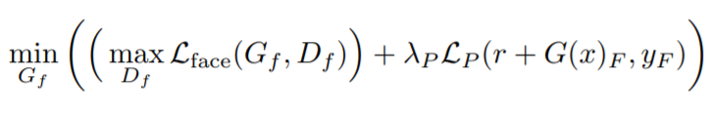
Video2video translation
Everybody dance now
Pretrained SOTA pose detector
Temporal smoothing: second frame conditioned on first one
Face GAN: enhance local realism
Trained with main G and D fixed
Notes:
L_p: perceptual loss

Slide 23
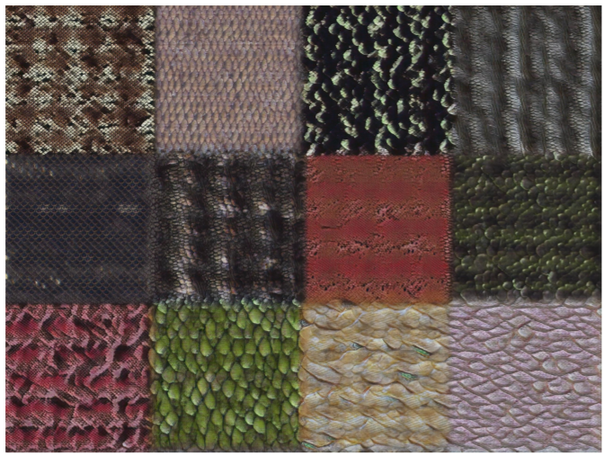
Texture synthesis
Goal: generate images with similar properties from a given image
Random noise characteristics
Favor fully conv. Layers: scale to diff. images
Vanilla DCGAN fails to align far away
regions
Extend latent code Z
Local independent part
Global part
Periodic part
Notes:
L_p: perceptual loss

Slide 24
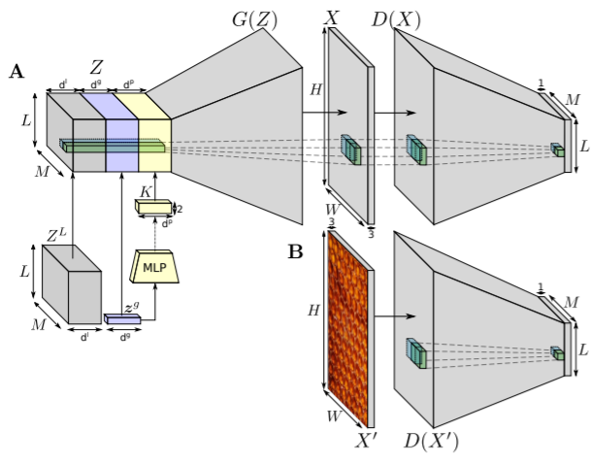
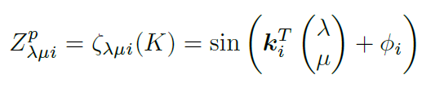
Texture synthesis
Extend latent code Z
Local independent part
allows spatial variance and diversity
Global part
Periodic part
d_p spatial periodic functions
Notes:
Lambda mu: coordinate, phi_i: random offset

Slide 25
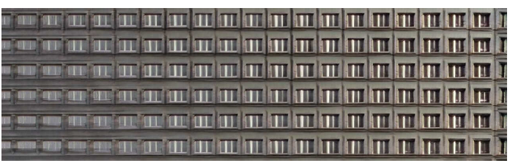
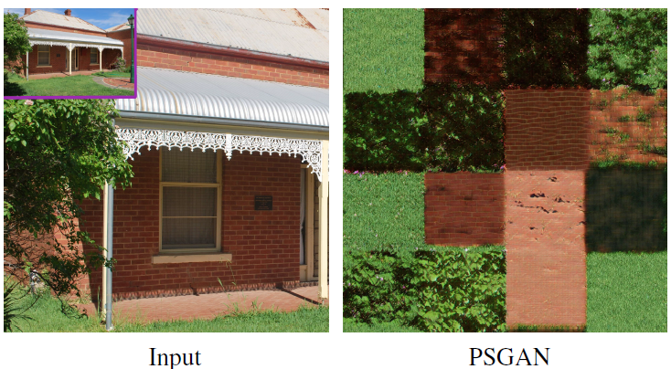
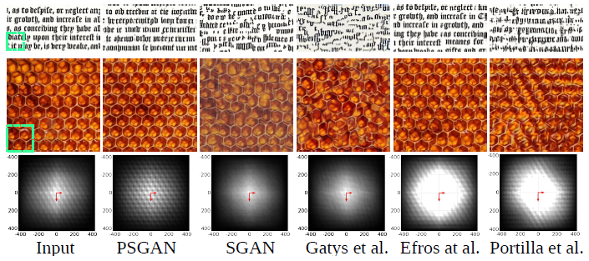
Texture synthesis
Extend latent code Z
Local independent part
Global part
Periodic part
Notes:
Inverse wave number

Slide 26
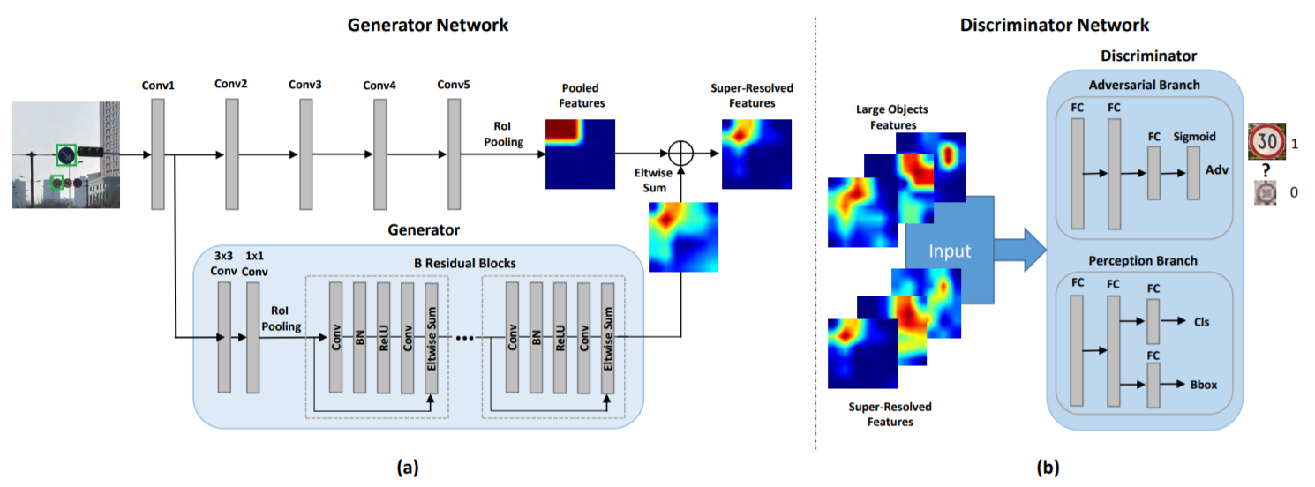
Object detection
Generative methods as data augmentation
Detecting small objects: challenging!
Generator: transform poor features to highly discriminative ones
Discriminator: differentiate generated and origin features, and justify detection accuracy benefits
Notes:
Two stage detection

Slide 27
Object detection
Generative methods as data augmentation
Generator: conditioned on low level features to generate the residual representation btw. large/small objects
First train perceptual branch and bottom conv. layers
Notes:
Two stage detection

Slide 28
Reference
PROGRESSIVE GROWING OF GANS FOR IMPROVED QUALITY, STABILITY, AND VARIATION
LARGE SCALE GAN TRAINING FOR HIGH FIDELITY NATURAL IMAGE SYNTHESIS
A Style-Based Generator Architecture for Generative Adversarial Networks
Arbitrary style transfer in real-time with adaptive instance normalization
A Closed-Form Solution to Universal Style Transfer
everybody dance now
Learning Texture Manifolds with the Periodic Spatial GAN
Perceptual Generative Adversarial Networks for Small Object Detection

